Slide 1
The inverters are generally classified into
Voltage Source Inverter (VSI) which produces a defined voltage waveform for the load.
Current Source Inverter (CSI) which outputs a defined current waveform for the load .

Slide 2
CURRENT SOURCE INVERTERS (CSI)
Power transfer takes place between an adjustable direct current source and an ac load
Current Source (Front end of the CSI)
consists of
a controlled rectifier bridge or a dc chopper.
A filter is connected to obtain ripple free output current.
Inverter
converts direct current at the input to an alternating current at the output.
Frequency and magnitude of the output are controlled by the control circuitry of the inverter.
output load has a defined current waveform

Slide 3
CSI from ac source

Slide 4
CSI from dc source

Slide 5
Two types of CSI are commonly used in the MV drive:
1. load-commutated inverter (LCI).
2. PWM inverters
LCI employs thyristors whose commutation is achieved by additional commutating circuits.
suitable for very large synchronous motor drives with a power rating up to 100 MW.
The PWM inverter uses switching devices with self-extinguishable capability.

Slide 6
Load Commutated Inverter (LCI)
Single Phase CSI with Ideal Switches
Load current has definite shape
Load voltage waveform depends on the nature of load

Slide 7
Three Phase CSI with Ideal Switches

Slide 8
Single Phase Capacitor Commutated CSI
Capacitor is used to commutate the devices.
For t < 0, S₃ & S₄ were conducting.
i_{o} was negative
v_{c} = -v₁
At t = 0, S₁ & S₂ are turned on

Slide 9
0 < t < T/2
S₁ & S₂ are on
V_{c} increases from -v₁ to +v₁.
v_{o} = v_{c}
i_{o} = v_{c}/R, i_{ac} = I_{dc}
v_{in} = v_{c}
i_{c} = i_{ac} - i_{o} = I_{dc} - i_{o}
i_{S1} = I_{dc =} i_{S2}
v_{S1} = 0
At t =T/2, S₃ & S₄ are turned on.
S₁ & S₂ are turned off due to v_{c}.

Slide 10
T/2 < t < T
S₃ & S₄ are on
V_{c} changes from +v₁ to -v₁
.
i_{o} = v_{c}/R, i_{ac} = -I_{dc}
v_{o} = v_{c} v_{in} = - v_{c}
v_{S1} = v_{c}
i_{c} = i_{ac} - i_{o} = -I_{dc} – i_{o}
i_{S3} = I_{dc =} i_{S4}

Slide 11
i_{ac} has definite shape and resolved into its Fourier Components.
Fundamental component of i_{ac} is at the frequency of 1/T
Period T is determined by the gating circuit.
Higher order harmonics are bypassed through the capacitance.
Load current and voltage waveforms depends on the relative values of Rand C

Slide 12
Time Domain Analysis
0 < t < T/2
At t = T/2, i₀(t) = +I₁

Slide 13
t_{c} is the turn off time provided by the circuit for a device.
V_{c} at t = t_{c} is 0
i₀(t)R at t = t_{c} is 0

Slide 14
Square wave mode
At low values of inverter frequency, I₁ =
I_{dc} and load current approximates square wave.
To get square wave, T must be > 10 RC
Also,
If t_{q} is the turn off time of the devices used, then, t_{c} should be greater than t_{q.}
minimum value of t_{c} should be t_{q.}
minimum value of 0.69RC should be t_{q.}
Minimum value of C must be t_{q} / 0.69R
C is selected as
R is the available load resistance
C = t_{q} / 0.69R

Slide 15
To get square wave, T must be > 10 RC
To get square wave load current,
For a given load R and device turn off time t_{q},
C is selected as C = t_{q} / 0.69R and
maximum frequency of operation is limited to 0.069/t_{q}

Slide 16
Sine wave mode of output current
For higher range of frequency, capacitance offers low impedance for harmonics and load current approximates sine wave.
Third harmonic is the most dominant harmonic.
C is selected such that its impedance for third harmonics X_{C3} is less than 50% of R at minimum value of the range of frequency.
All higher harmonics will be bypassed from load resistance to capacitance.

Slide 17
Maximum frequency of operation is limited such that
turn off time t_{c} provided by the circuit
is greater than device turn off time t_{q}

Slide 18
Single Phase Load Commutated CSI with Purely inductive Load

Slide 19
At low frequency of inverter operation, Output Current waveform approximates Square waveform. This low frequency range is called No overlap region.
At higher frequency of inverter operation, Output Current waveform approximates Sine waveform. This frequency range is called Fully overlap region
Frequency range greater than no overlap region and lesser than fully overlap region is called Partial overlap region of frequency

Slide 20
CSI in No-Overlap frequency range
One cycle of load current
is divided into 6 modes.
Prior to mode 1,
S₁ and S₂ were conducting
Load current path was
S₁, D₁, load, D₂ and S₂.
For t ≤ 0 ,
i₀(0) = I_{dc}, V_{c}(0) = -V_{co}
i_{c}(0) = 0

Slide 21
Mode -1
S₃ and S₄ are turned on.
S₁ and S₂ are turned off
due to –V_{CO} .
Load current remains at I_{dc}
Current path is
Current source, S_{3 ,} C, D₁,
load, D₂, C, S_{4.}
V_{C} varies linearly due to constant current I_{dc}

Slide 23
Mode -2
When V_{c} = 0, D₃ and D₄ become on.
L & C are shorted through D₁, D₂, D₃ and D₄ .
Current enters to L, C parallel circuit
through S₃ and leaves through S₄
By KCL,
2i_{c}
V₀ = -V_{c}

Slide 24
Mode 2 ends when i_{c} = 0
i₀ = - I_{dc}
Duration for Mode -2
t₂ = π/2ω₀
Current Commutation Interval
t_{c} = t₁ + t₂
As i_{c} = i_{diode}= 0, D₁ and D₂ become off.

Slide 25
Mode -3
Current path is
Source, S₃,D₃, load, D₄,
and S₄
i_{c} = 0
i₀ = -I_{dc}
This mode continues till
S₁ and S₂ are turned on at T/2.
t₃ = T/2 - (t₁+t₂)
= T/2 - (1+π/2)/ω₀

Slide 26
Transition Diagram of 1Ф CSI in No-Overlap Region of Frequency
For No-Overlap range of Frequency, sequence of operating modes is 1,2,3,4,5,6
Commutation interval
t_{c} =
Duration of mode3
t₃ =

Slide 27
When inverter frequency is increased, T is decreased and t₃ is also decreased.
At the limiting value of no overlap range of frequency, t₃ becomes zero.
T_{NL} is the minimum period for no overlap condition.
Maximum frequency limit for no overlap condition.

Slide 28
PARTIAL OVERLAP FREQUENCY RANGE
Inverter Frequency is greater than f_{NL}
Modes 3 and 6 are absent.
For t < 0, the inverter
was in mode 5.
S₁,S₂,D₁,D₂,D₃,D₄ were
Conducting.
Load current was oscillatory.
i_{c} and v_{c} were –ve, i₀ is +ve

Slide 29
At t = 0, S₃,S₄ are turned on.
S₁,S₂ are turned off.
This results in mode 2 operation.
i_{c} becomes +ve and rises in the
+ve direction.
i₀ which is +ve rises to a
constant value I_{dc}
V_{c} rises with a +ve slope.
Drop across the load becomes
zero due to constant current of I_{dc} .
D₃, D₄ are turned off.

Slide 30
This results in mode1 operation.
Current path: source, S₃, C, D₁, load, D_{2,} C ,S₄
Mode1 ends when v_{c} = 0
D₃, and D₄ are brought
into conduction resulting
mode 2 condition.
V_{c} rises in the +ve direction
i₀ reverses to a value
less than I_{dc}

Slide 31
In partial overlap condition, Sequence of modes in one cycle is 2,1,2,5,4,5
Maximum frequency limit for partial overlap condition is

Slide 32
FULLY OVERLAP CONDITION
If the inverter frequency is further increased, all the diodes conduct continuously resulting in sine wave load current.
In fully overlap condition, Sequence of modes in one cycle is 2,5

Slide 33
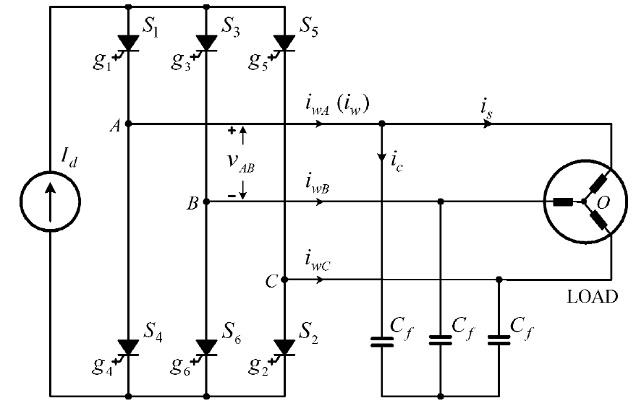
PWM IN THREE PHASE CURRENT SOURCE INVERTER
The inverter produces a defined PWM output current i_{w}.
DC side of the inverter is an ideal dc current source I_{d}.

Slide 34
The CSI requires a three-phase capacitor C_{f} at its output for the commutation of the switching devices.
The capacitor provides a current path
for the energy trapped in the load
inductance which would otherwise
cause high-voltage spike leading to
the damage of the switching devices.
The capacitor also acts as a harmonic
filter, improving the load current and
voltage waveforms.
The capacitor value can be reduced with the increase of the switching frequency.

Slide 35
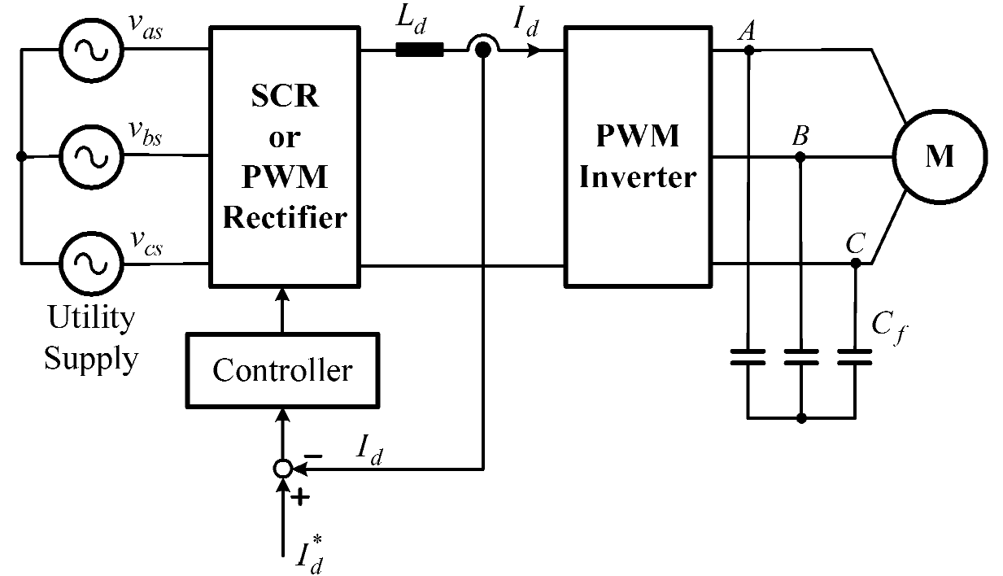
The dc current source I_{d} can be realized by a voltage source rectifier with a dc current feedback control.
To make the dc current I_{d} smooth and continuous, a dc choke L_{d} is used.
The magnitude of I_{d} is kept at a value set by its reference I_{d}* by the feedback control scheme.

Slide 36
Switching pattern for the CSI should satisfy the following conditions.
1. I_{d} should be continuous
two devices one from top group and
one from bottom group should conduct at a time.
If only one device conducts, then there is no
path for continuous current and high
voltage will be induced by the dc choke.
This causes damage to the switches.
2. inverter current i_{w} should be defined
If S₁, S₂ and S₃ are conducting at a time,
the currents in S₁ and S₃, equal to the
PWM currents in the inverter phases A and B which is load-dependent.
sum of the two currents is equal to I_{d}.
If more than two devices conduct at a time,
then load phase currents are not defined by
switching pattern.

Slide 37
SPACE VECTOR MODULATION
Only two switches, one from upper group and one from lower group, in the inverter conduct at a time.

Slide 38
Three Zero states
1,4 3,6 5,2
DC side current is bye passed.
i_{wA} = 0, i_{wB} = 0, i_{wC} = 0
Bypass operation.
Type of state | Switching state | On-state switch | Inverter PWM current |  |  | Space vector
 |  |  | i_{wA} | i_{wB} | i_{wC}
Zero States | 1,4 | S₁,S₄ | 0 | 0 | 0
 | 3,6 | S₃,S₆ | 0 | 0 | 0
 | 5,2 | S₅,S₂ | 0 | 0 | 0

Slide 39
Six Active states
Load is 3 phase balanced
Type of state | Switching state | On-state switch | Inverter PWM current |  |  | Space vector
 |  |  | i_{wA} | i_{wB} | i_{wC}
Zero States | 1,4 | S₁,S₄ | 0 | 0 | 0
 | 3,6 | S₃,S₆ | 0 | 0 | 0
 | 5,2 | S₅,S₂ | 0 | 0 | 0
Three phase currents can be transformed into two phase currents in the α-β plane.
Current space vector can be expressed in terms of two phase currents as
Active
states
AA | 6,1 | S₆,S₁ | I_{d} | -I_{d} | 0
Substituting for I_{α} and I_{β}
For switching state [6 1], S₁ and S₆ are on

Slide 40
Six Active states
Active vectors can be expressed as
Type of state | Switching state | On-state switch | Inverter PWM current |  |  | Space vector
 |  |  | i_{wA} | i_{wB} | i_{wC}
Zero States | 1,4 | S₁,S₄ | 0 | 0 | 0
 | 3,6 | S₃,S₆ | 0 | 0 | 0
 | 5,2 | S₅,S₂ | 0 | 0 | 0
AA | 6,1 | S₆,S₁ | I_{d} | -I_{d} | 0
 | 1,2 | S₁,S₂ | I_{d} | 0 | -I_{d}
Active
states
Active States | 2,3 | S₂,S₃ | 0 | I_{d} | -I_{d}
 | 4,5 | S₄,S₅ | -I_{d} | 0 | I_{d}
 | 5,6 | S₅,S₆ | 0 | -I_{d} | I_{d}
 | 3,4 | S₃,S₄ | -I_{d} | I_{d} | 0

Slide 41
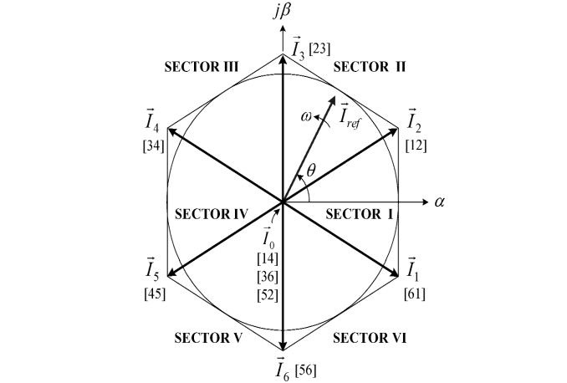
Active vectors form a regular hexagon with 6 equal sectors.
Zero vector lies on the center.

Slide 42
Active vectors and zero vectors do not move in space and they are referred to stationary vectors.
Current reference vector rotates in space at an angular velocity ω = 2πf₁
f₁ is the required fundamental frequency of the inverter output current.
Angular displacement between and the α axis of the α-β plane is
For any position of it can be synthesized by three near by stationary vectors.
Magnitude of output current is adjusted by adjusting the length of reference phaor
and frequency by adjusting the speed of rotation

Slide 43
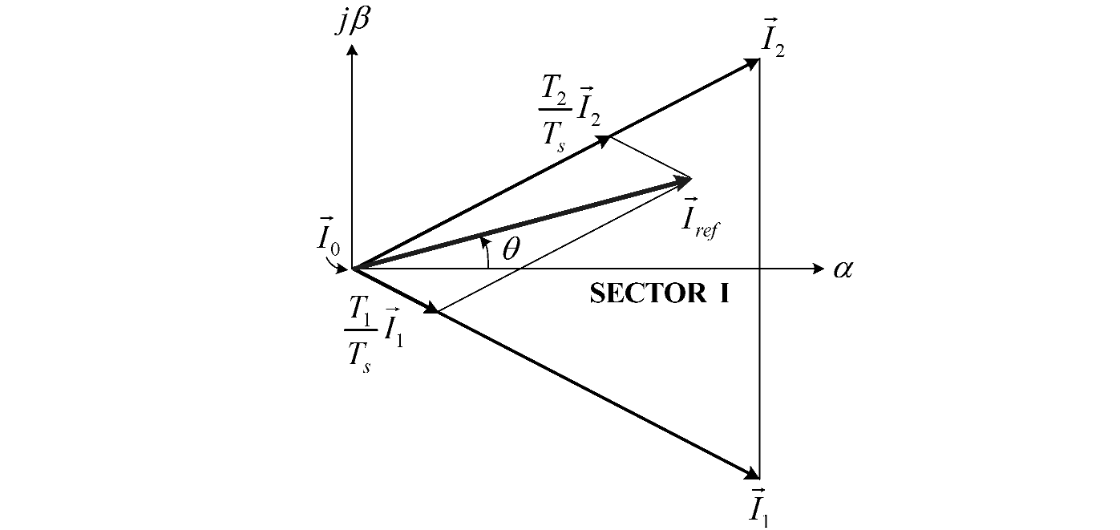
Dwell Time Calculation
Let lies in sector I.
Inverter switches are controlled
such that, states of the inverter
shifts between states 1, 2 and 0 on a part time basis so that the resultant current vector agrees closely with
Sampling period T_{s} = T₁ + T₂ + T₀
By the ampere- second balancing equation .
T_{1 ,} T₂ and T₀ are dwell times along

Slide 44
Splitting this into real axis and imaginary axis components,

Slide 45
Maximum value of reference vector I_{refmax} corresponds to the radius of the largest circle that can be inscribed in the hexagon.
Length of active vector is

Slide 46
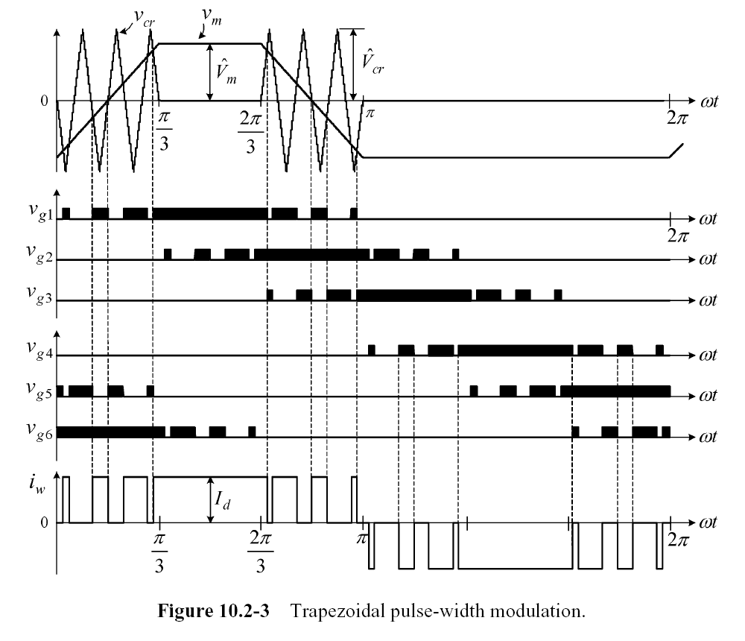
Trapezoidal PWM (TPWM)
v_{m} is the trapezoidal modulating wave and v_{cr} is a triangular carrier wave.
The amplitude modulation index is defined by
are the peak values of the modulating and carrier waves, respectively.
Only two devices conduct at a time, resulting in a defined i_{w}.
The magnitude of i_{w} is set by the dc current I_{d}.

Slide 47
Fundamental-frequency component I_{w1} does not vary significantly with the modulation index m_{a}.
When m_{a} varies from zero to its maximum value of 1.0,
I_{w1} changes from its minimum value of 0.89 I_{w1max} to I_{w1max}, presenting only an 11% increase.
This is due to the fact that i_{w} is not modulated in the centre ∏/3 region of each half-cycle.
In practice, the adjustment of fundamental component I_{w1} is accomplished by varying the dc current I_{d} through the input side rectifier instead of varying m_{a}.

Slide 48
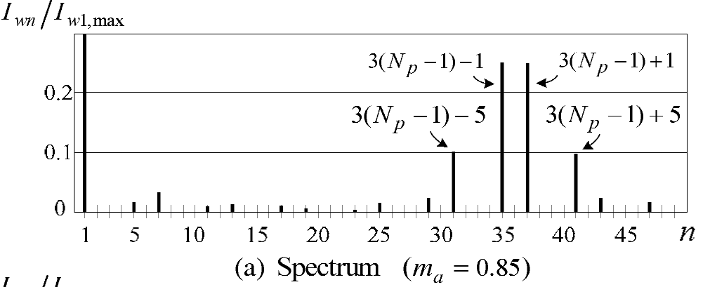
The switching frequency of the devices is f_{sw} = f₁ × N_{p}
f₁ is the fundamental frequency
N_{p} is the number of pulses per half-cycle of i_{w}.
I_{wn} is the rms value of the nth-order harmonic current in i_{w}
I_{w1max} is the maximum of rms values of fundamental-frequency current
The PWM current i_{w} does not contain any even-order harmonics since its waveform is of half-wave symmetry.
N_{p} = 13 and m_{a} = 0.85.
The TPWM scheme produces two pairs of dominant harmonics at
n = 3(Np – 1) ± 1 and
n = 3(Np – 1) ± 5,
which are the 31st, 35th, 37th, and 41st for N_{p}=13.

Slide 49
Selective Harmonic Elimination PWM
To eliminate a number of low-order unwanted harmonics in the inverter PWM current i_{w}.
The switching angles are pre-calculated and then imported into a digital controller for implementation.

Slide 50
The inverter PWM current i_{w} can be expressed as
To eliminate k harmonics, k equations can be made by setting a_{n} = 0,

